Slide 1

St. Francis Institute of Technology Department of Computer Engineering Mini Project – Sem VI
TEXT COMPRESSION USING ML
Group Members
Name of Student | Class-Roll No.
Yukta Mandekar | TE CMPN A/A-41
Priya Nawal | TE CMPN A/A-44
Suraj Negi | TE CMPN A/A-45

Slide 2
CONTENT
Introduction
Literature
Problem Statement
Work flow of the system
Algorithm Used
Data set description
Working demo along with validation Results/Analysis
4/17/2019
Text Data Compression using ML

Slide 3
Introduction
Data compression is a technique of reducing the number of bits needed to store or transmit data.
Data compression is crucial because it helps reduce the consumption of expensive storage and transmission devices.
Currently the rate of data generation is increasing rapidly and the storage and transmission is getting inevitably expensive so the need of a system to compress data is immense .
4/17/2019
Text Data Compression using ML

Slide 4
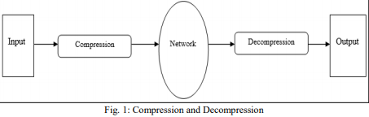
4/17/2019
Text Data Compression using ML

Slide 5
LITERATURE
Title | Objective of the paper | Inference
Text Data Compression Algorithm using Hybrid Approach[1] | To perform lossless compression using dynamic bit coding and Huffman Algorithm | We learnt about the efficiency of Huffman Algorithm .
Deepzip: Data Compression using Recurrent Neural Networks[2] | To perform lossless compression using Recurrent Neural Network | We learnt that RNN is the most effective deep learning algorithm for data compression.
4/17/2019
Text Data Compression using ML

Slide 6
Objective:
The objective of this project is to compress and decompress the text file in a lossless manner.
Scope:
The more we train data on the system the higher the compression ratio will get.
This system can also be used to compress the image, audio and video files.
4/17/2019
Text Data Compression using ML

Slide 7
Problem Statement
To perform lossless compression and decompression of the text data file to store it efficiently and also to upload and transform it faster by reducing the cost of data storage using Recurrent Neural Network.
4/17/2019
Text Data Compression using ML

Slide 8
Work Flow of the system
Input the raw text data
Preprocessing of the data
Convert the text into bits
Compress the size of the file using RNN
Preprocessing the compressed data
Text data file with reduced size
Decompression of the text data file
Decompression of text data file
4/17/2019
Text Data Compression using ML

Slide 9
Description of data set
Text Data files from various sources with maximum file size upto 15 mb
4/17/2019
Text Data Compression using ML

Slide 10
ALGORITM USED
RECURRENT NEURAL NETWORK(RNN):
Recurrent Neural Network(RNN) are a type of neural network where the output from previous step are fed as input to the current step.
In traditional neural networks, all the inputs and outputs are independent of each other, but in cases like when it is required to predict the next word of a sentence, the previous words are required and hence there is a need to remember the previous words.
Thus RNN came into existence, which solved this issue with the help of a Hidden Layer.

Slide 11
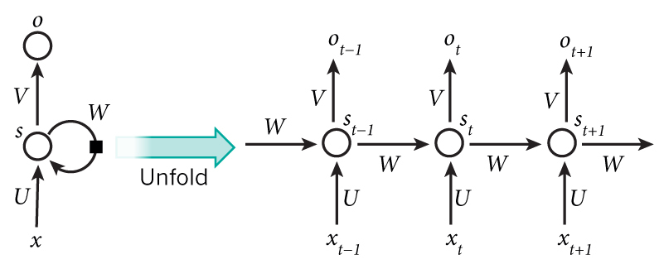
4/17/2019
Text Data Compression using ML

Slide 12


Formula for calculating current state:
Where, ht→current state
ht-1→ previous state
Xt→ input state
Formula for applying activation function
Whh→ weight at recurrent neuron
Wxh→weight at input neuron
Formula for calculating output:
4/17/2019apll
Text Data Compression using ML

Slide 13

Formula for calculating output:
Yt→output
Why→weight at output layer
A single time step of the input is provided to the network.
Then calculate its current state using set of current input and the previous state.
The current ht becomes ht-1 for the next time step.
One can go as many time steps according to the problem and join the information from all the previous states.
4/17/2019
Text Data Compression using ML

Slide 14
Once all the time steps are completed the final current state is used to calculate the output.
The output is then compared to the actual output i.e the target output and the error is generated.
The error is then back-propagated to the network to update the weights and hence the network (RNN) is trained.
4/17/2019
Text Data Compression using ML

Slide 15
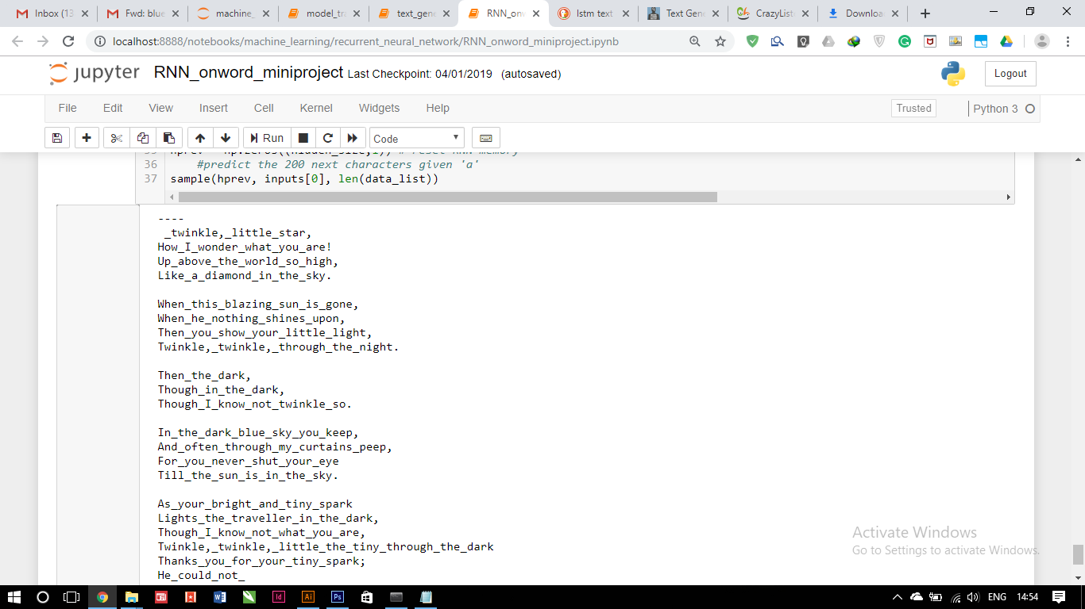
Working demo along with validation
TEST CASE (POEM)
4/17/2019
Text Data Compression using ML

Slide 16
COMPRESSED FILE:
4/17/2019
Text Data Compression using ML

Slide 17
Validation And Accuracy
4/17/2019
Text Data Compression using ML

Slide 18
RESULTS:
Size of the file | Compressed size of the file
1 KB | 2 KB
116 KB | 147 KB
11,606 KB | 11,250 KB
15,892 KB | 15,891 KB
3,016 KB | 2,626KB
4/17/2019
Text Data Compression using ML

Slide 19
Conclusion
We have tried to compress the text data files And obtain the lossless decompression of the text file.
We successfully reduced the size of the text file to 0.3% of its original size.
The rate of data generation is increasing rapidly, so data compression helps in reducing the rate of the storage devices and efficiently transforming the file.
4/17/2019
Text Data Compression using ML

Slide 20
References
Petrie KJ, Mueller JT, Schirmbeck F, Donkin L, Broadbent E, Ellis CJ et al. Effect of providing information about normal test results on patients’ reassurance: randomised controlled trial. British Medical Journal [Online] 2007;334(7589): 352-354. Available from: doi: 10.1136/bmj.39093.464190.55 [Accessed 26th August 2011].
Treloar, D 1999, 'Grains of sense', Australian Gourmet Traveller, November, pp. 29-30, 64.
MacFarlane, I 2002, 'Aboriginal society in North West Tasmania: dispossession and genocide', PhD thesis, University of Tasmania.
4/17/2019
Text Data Compression using ML

